Slide 1


Hii, Iam Siddhika
Welcome to Power BI Series
Part -20

Slide 2

Today Content
I’m soo Excited.
Are you ready guys?
Meet DAX
CALCULATED COLUMNS
VS. MEASURES TIP: MEASURE TABLES

Slide 3

CALCULATED COLUMNS VS. MEASURES
CALCULATED COLUMNS
Values are calculated based on information from each row of a table (row context)
Appends static values to each row in a table and stores them in the model (which increases file size)
MEASURES
Have you got it?
Values are calculated based on information from any filters in the report (filter context)
Does not create new data in the tables themselves (doesn’t increase file size)

Slide 4


CALCULATED COLUMNS VS. MEASURES
CALCULATED COLUMNS
Recalculate on data source refresh or when changes are made to component columns
MEASURES
Recalculate in response to any change to filters within the report
Check this
Primarily used for filtering data in reports
Primarily used for aggregating values in report visuals

Slide 5
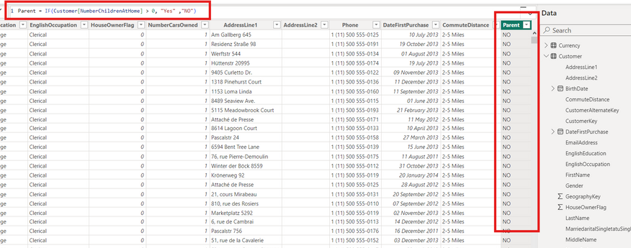

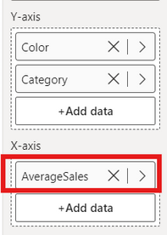
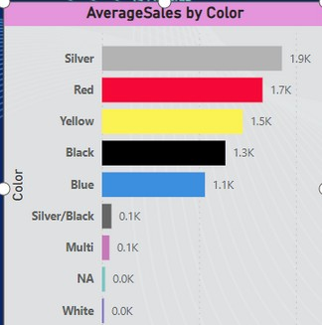

got it?
Calculated columns “live” in tables
Measures “live” in visuals

Slide 6
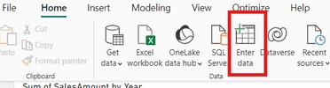

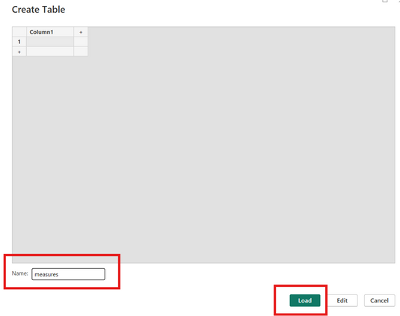

TIP: MEASURE TABLE
It’s a common best practice to create a dedicated table to store your measures; this will help you stay organized, find measures quickly, and allow you to group related measures into folders
Have you got it?
from the Report view
Option 1:Enter Data into Power Query (loads the table to the data model – table is visible in Power Query)
Add a table Name and click OK to load the table to the data model

Slide 7
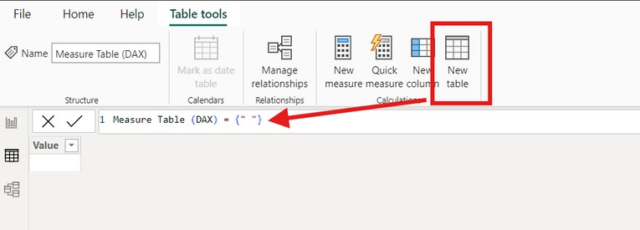
TIP: MEASURE TABLE
Option 2:Create a calculated table using DAX directly in the model (table is not visible in Power Query)
*from the Data view
Have you got it?
Create new table & use a table constructor { } to add a single column

Slide 8


Thank you for joining me today to learn about Part -20 of Power BI!
Remember, Learning DAX is key to unlocking the full potential of Power BI for insightful reporting and visualization.
Stay tuned for more insights and tips on Power BI in our next Series.
Follow
Siddhika Shah

